Slide 1
CSS #2
Robi Kurniawan, M.Kom

Slide 2
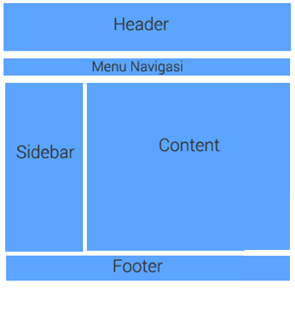
Template & Layout

Slide 3
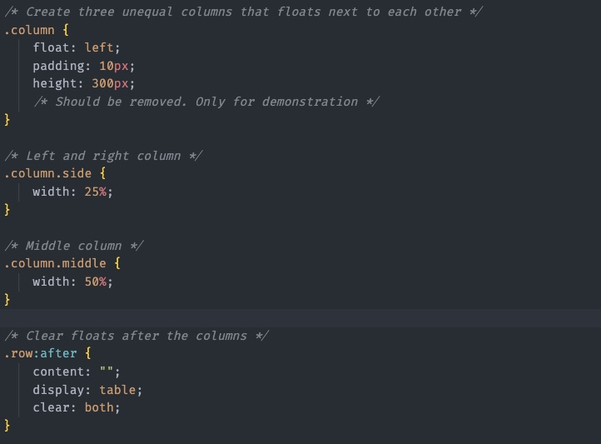
Code

Slide 4
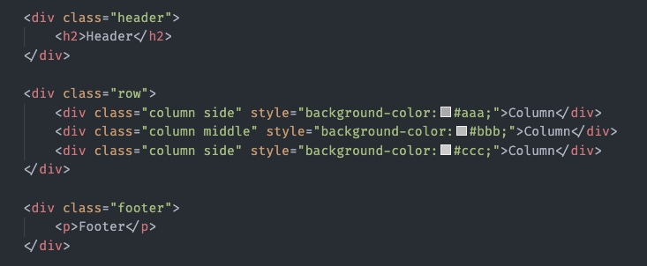

Slide 5
